Slide 1
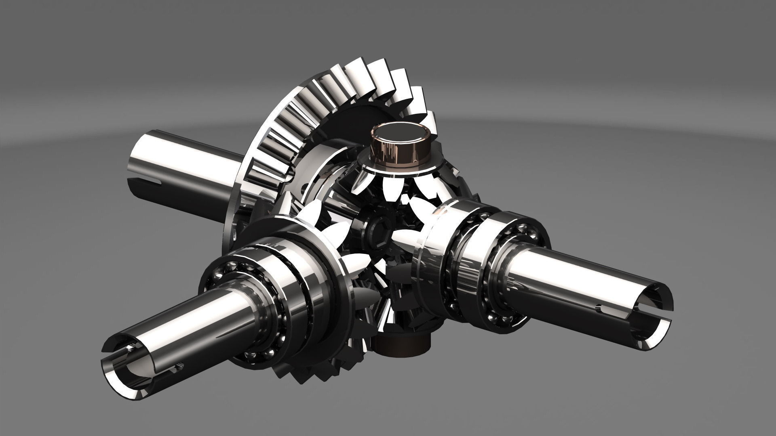
Understanding the Differential Gearbox
by Himanshu Sharma, Ansel Vaz, Abhishek Singh, Amit Sharma, Deep Sonawane

Slide 2
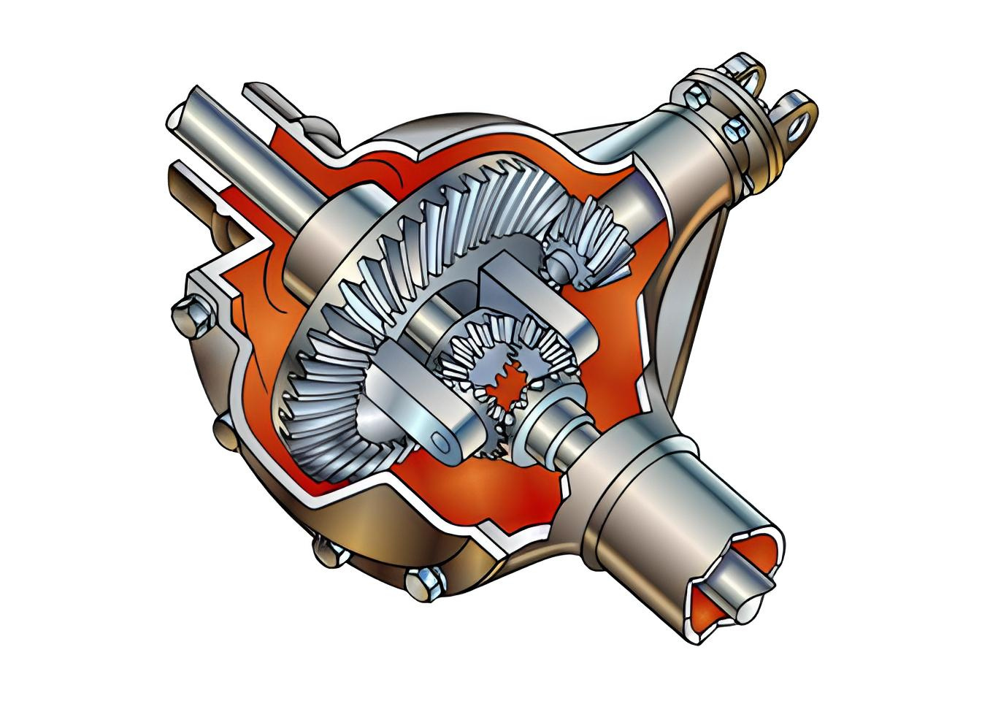
What is a
Differential GearBox?
It is a mechanical device that allows wheels to rotate at different speeds while receiving equal torque.

Slide 3
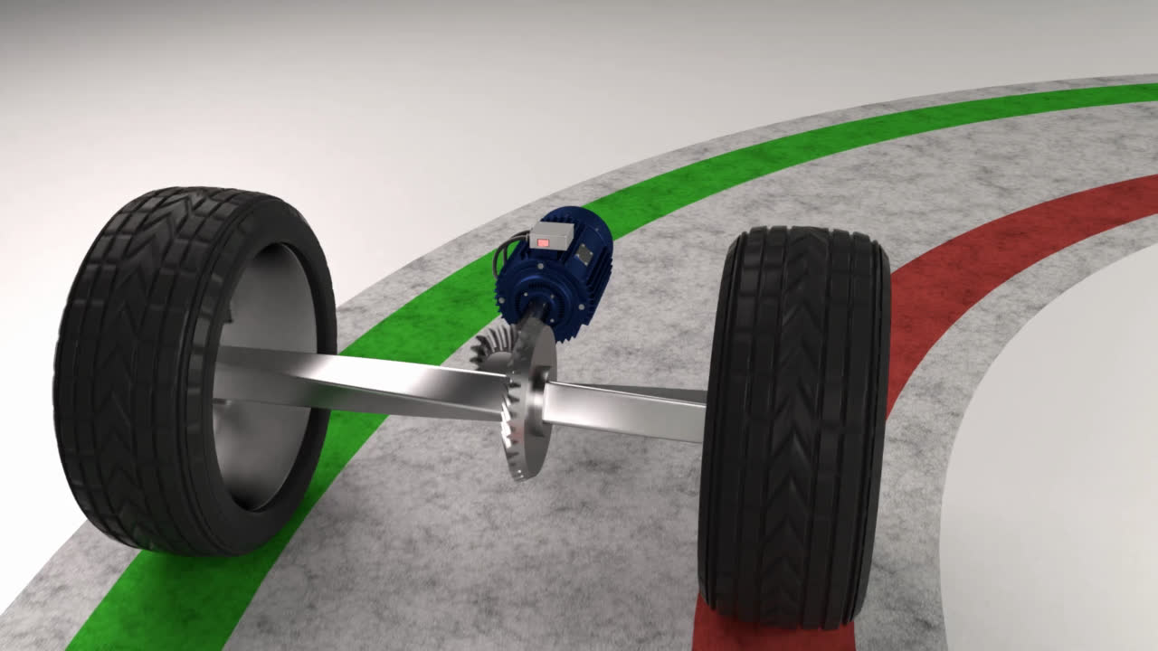

Slide 4
Working Principle:
1. Straight Movement:
- Power flows from the propeller shaft to the crown wheel via the pinion gear.
- Crown wheel, differential cage, planet pinions, and sun gears rotate together.
- No relative motion between sun gear and planet pinions.
- Both road wheels turn at the same speed.
2. Taking a Turn:
- Inner wheel faces resistance, rotates in the opposite direction.
- Differential allows wheels to travel different paths.
- Ensures optimal traction and stability during turns.

Slide 5
Functions
Speed Variation
Torque Multiplication/Reduction
Direction Reversal
Synchronization

Slide 6
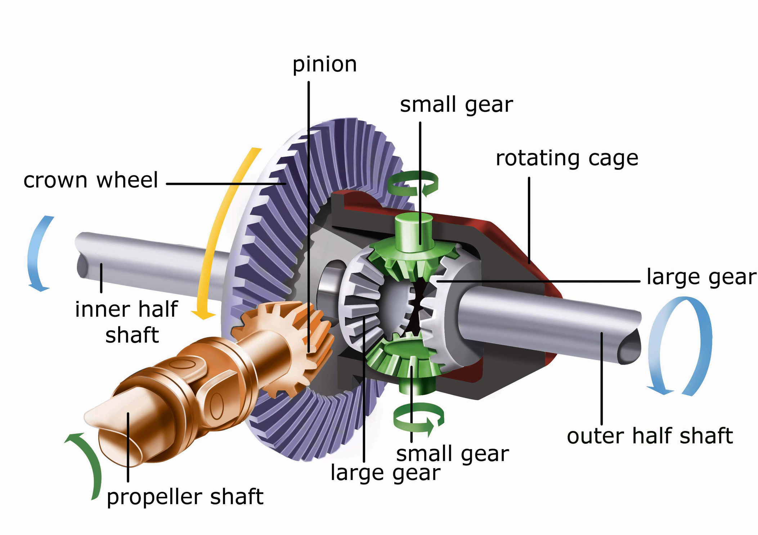
Components

Slide 7
References:
(1) Differential Gearbox: Diagram, Working, Types, Advantages, Uses. https://testbook.com/mechanical-engineering/differential-gearbox.
(2) Differential gear Box - Diagram, parts, Types, Working, Advantages. https://learnmech.com/working-of-differential-gear-box-for/.
(3) What is a Differential On A Car and How Does it Work? - Engineering Choice. https://www.engineeringchoice.com/what-is-differential-in-car/.
(4) https://testbook.com/mechanical-engineering/differential-gearbox
(5) https://learnmech.com/working-of-differential-gear-box-for/
(6) https://www.engineeringchoice.com/what-is-differential-in-car/

Slide 8
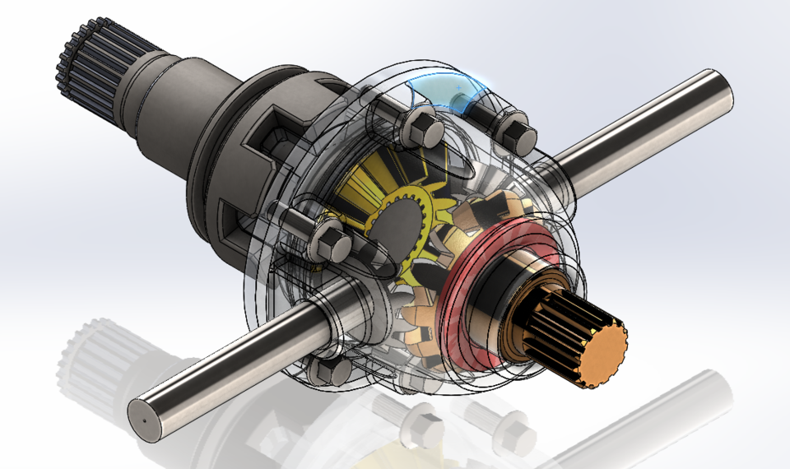
THANK YOU

